Slide 1
Comparative Analysis Of Gravity Model, Neural Network, And Graph Neural Network For Traffic Demand Modeling In Urban Areas
Relative Fields: Transportation Engineering, Traffic Engineering, Machine Learning, Neural Network with Pytorch
Steps:
code out the GM Model. We did this in 4 different approach. 1-exponentional 2-power 3-tanner 4-guess
The last approach (Guess) is made by me and is a new approach.
Model the NN and GNN
connect all details to get the results all together.

Slide 2
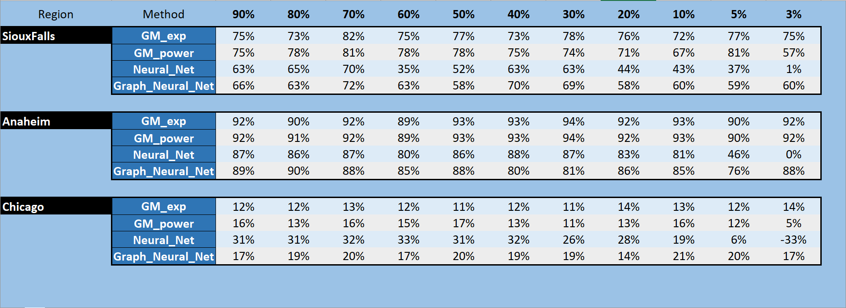


Slide 3
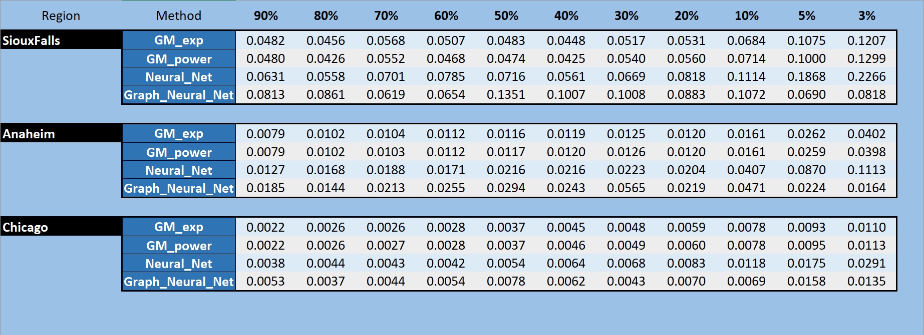

Slide 4
